Slide 1
Servlets

Slide 2
Hello World Servlet
Java class that is processed on the server
Java class generates HTML that is returned to browser
Can read HTML form data, use cookies and sessions etc…
At a high-level, similar functionality to JSPs

Slide 3
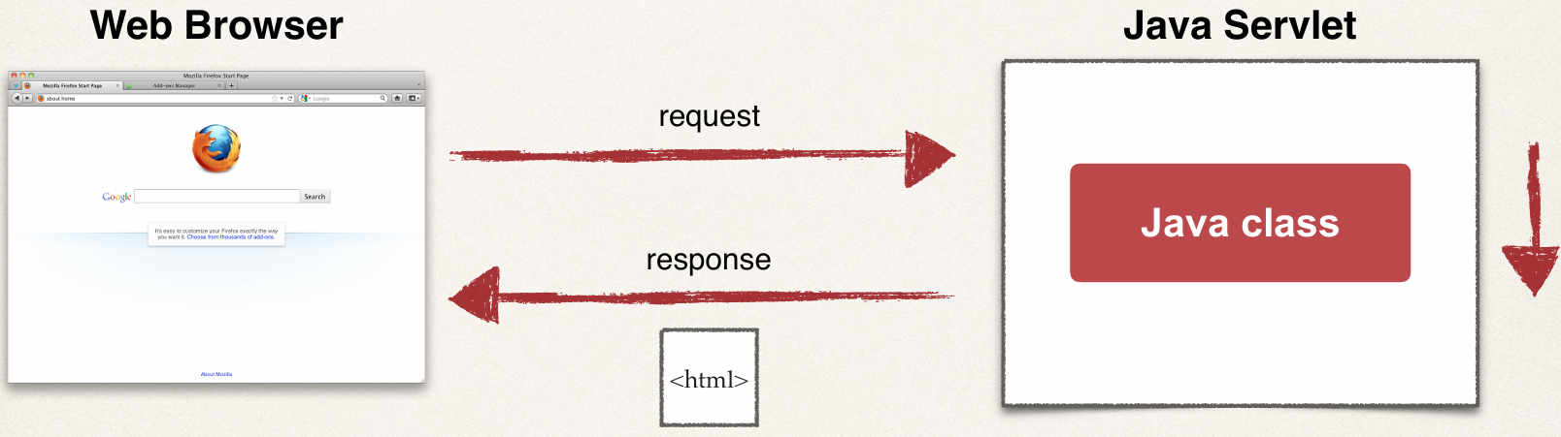
What Are Servlets?

Slide 4
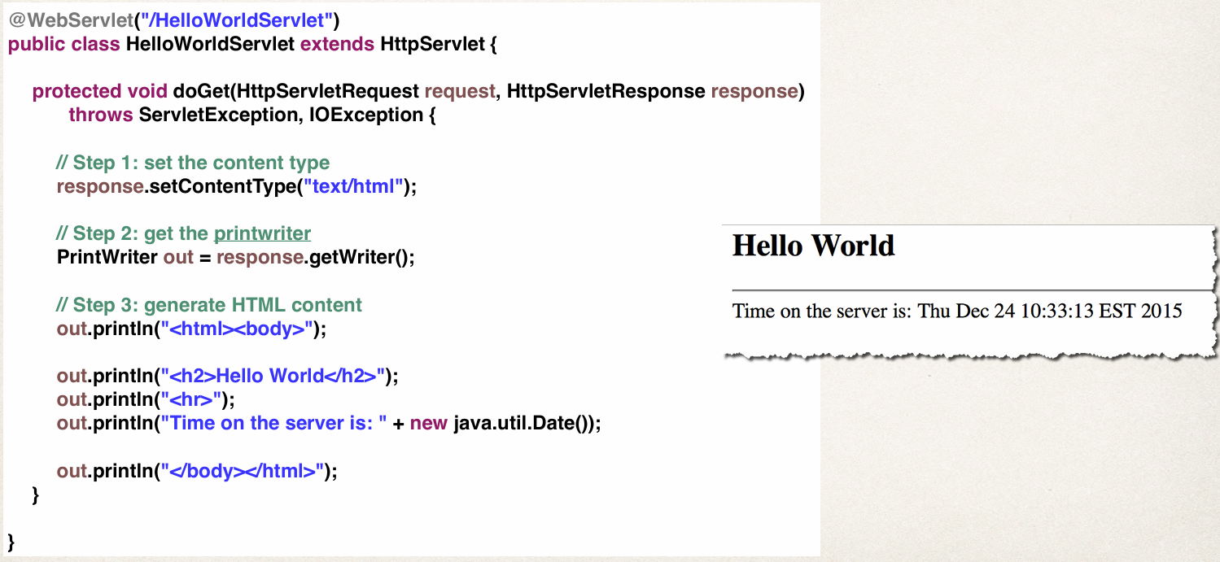
Show me the code!

Slide 5
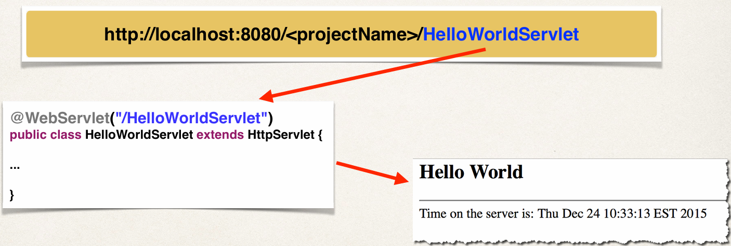
Access the Servlet
Use the path specified in WebServlet annotation

Slide 6
Comparing Servlets and JSP

Slide 7
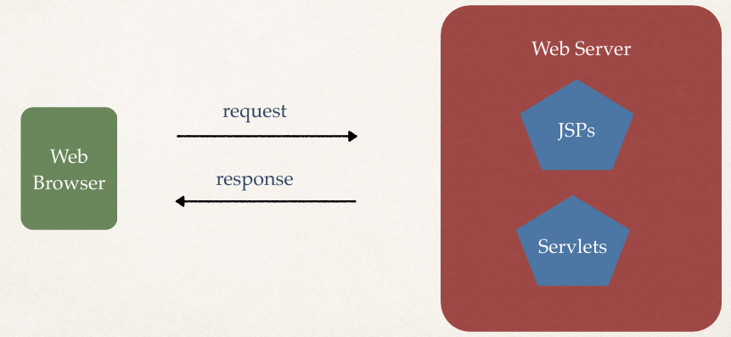
JSP and Servlets

Slide 8
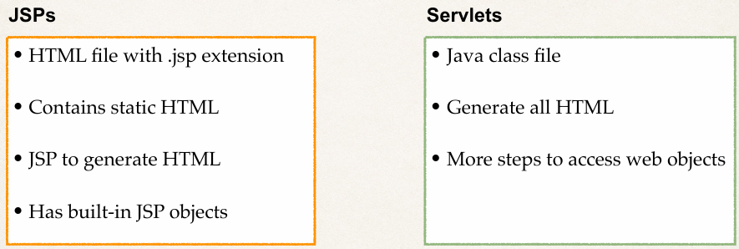
Comparing JSP and Servlets

Slide 9
Which One?
Can use either one for building Java web apps …
Build entire site using only Servlets … or
Build entire site using only JSPs

Slide 10
Best Practice
Integrate them both together!
Servlet does the business logic
JSP handles the presentation view
Model-View-Controller (MVC) Design Pattern

Slide 11
Reading HTML Form Data with Servlets

Slide 12
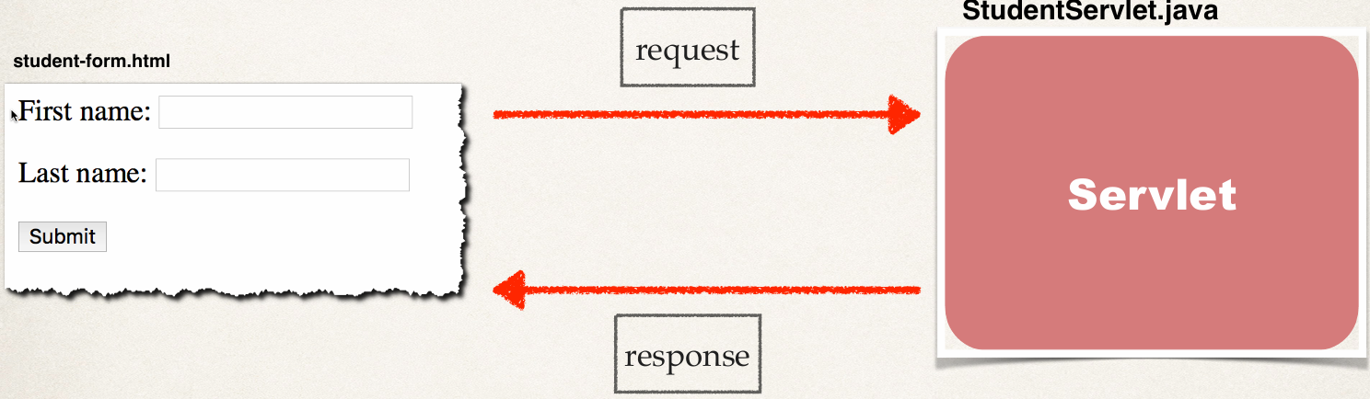
HTTP Request / Response

Slide 13
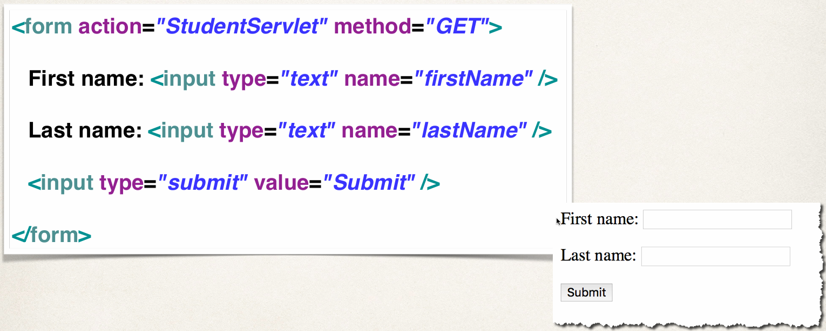
Step 1: Building HTML Form

Slide 14
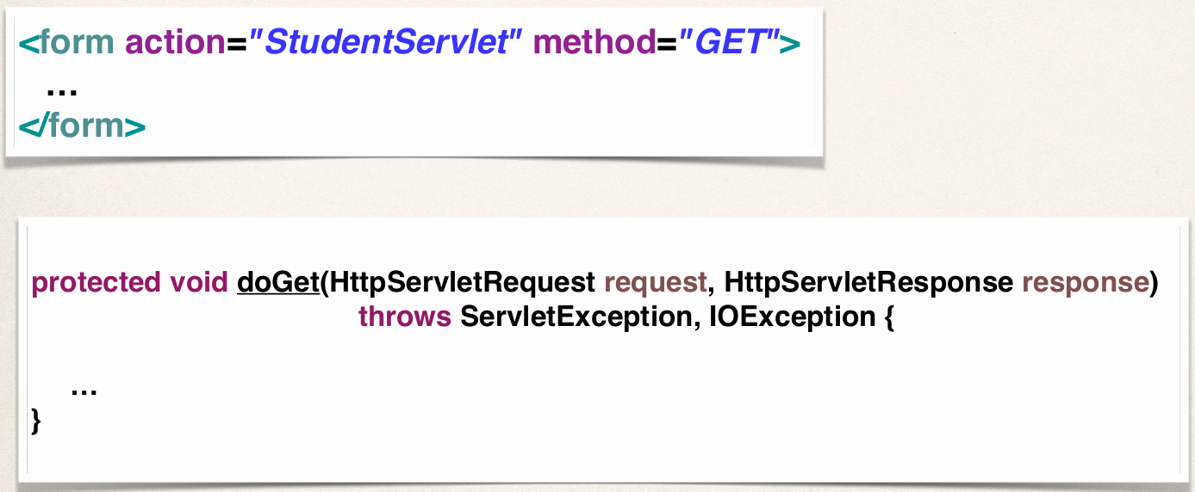
Form GET method calls Servlet doGet() method

Slide 15
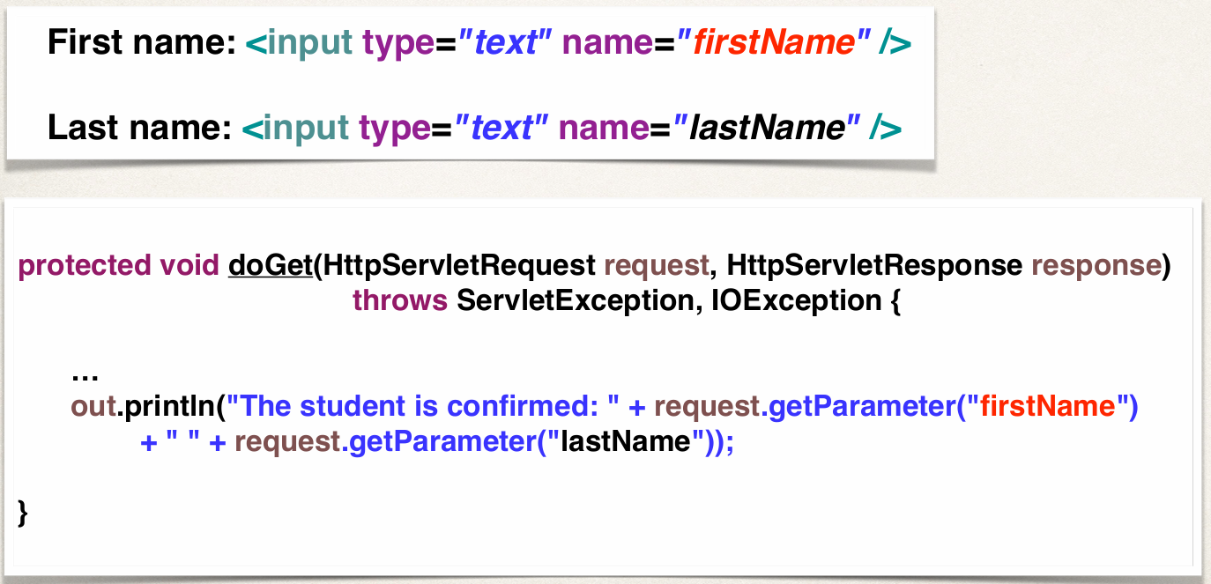
Step 2: Reading Form Data with Servlet

Slide 16
Difference between GET and POST

Slide 17
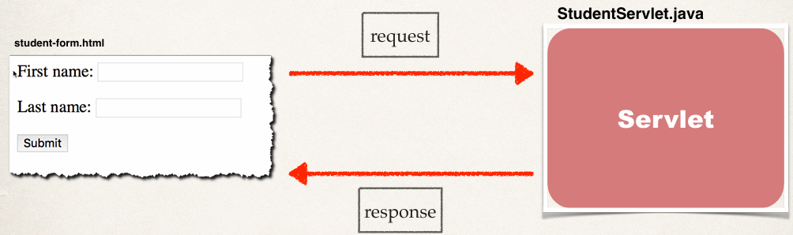
HTTP Request / Response

Slide 18
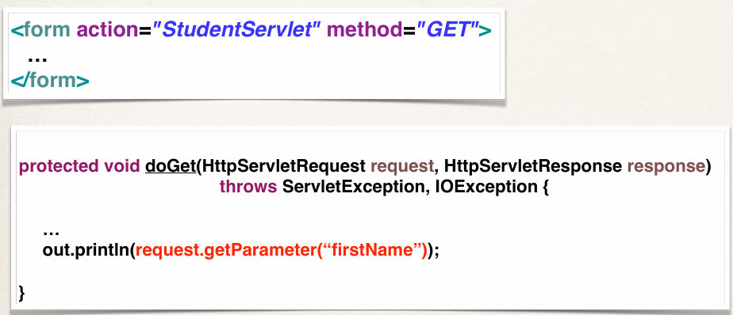
Form GET method calls Servlet doGet() method

Slide 19
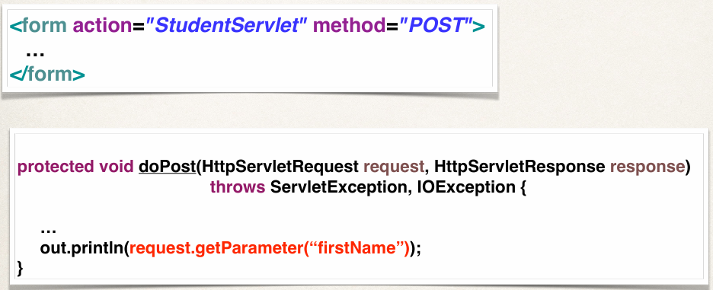
Form POST method calls Servlet doPost() method

Slide 20
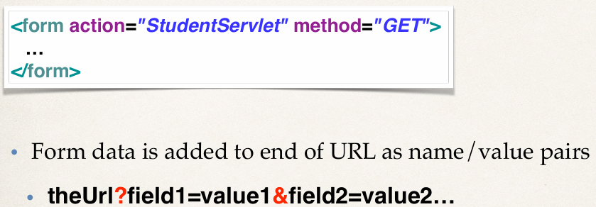
Sending Data with GET method

Slide 21
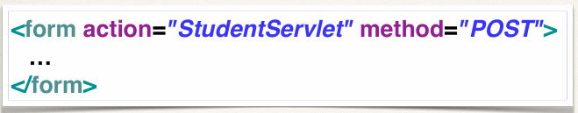
Sending Data with POST method

Slide 22
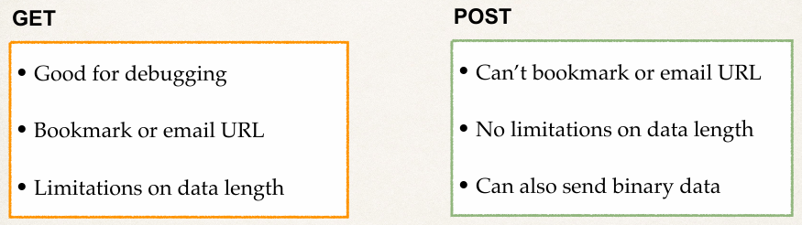
Well …. which one???

Slide 23
